Slide 1
IComparable Interface
Sarita Lad
What ? Why ? How ? Let us see the answers:

Slide 2
What is an interface?
In C# language multiple inheritance is not allowed , so if we want to add some common functionalities to a concrete class after inheriting from a base class , we have to use interface.
Interface is a special type of a class.
Interface is a provider of abstract methods with predefined signatures of functions :it provides flexibility of logic depending upon the entity.
Concrete class is a consumer which has to well implement these abstract methods by writing appropriate logic in these methods.
Interfaces can be user defined or system defined.
Collections Namespace have popular interfaces like IComparable,IEnumerable,IClonable ,ICollection etc.

Slide 3
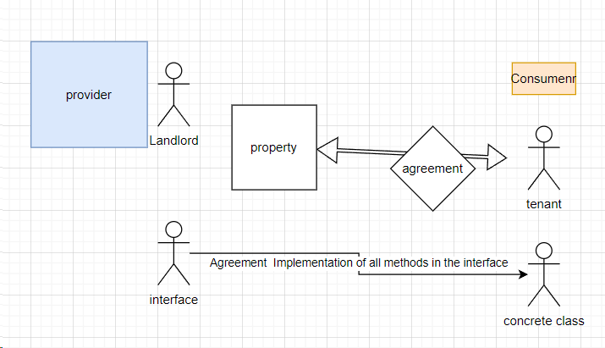
Real Life mapping:

Slide 4
Why we need IComparable interface ?
We use Generic Collection classes better than Arrays in C# to store multiple data items ex:List Stack , Queue etc.
In these Collections , we can store complex data like objects of different entities Like Book, Student, Product etc.
All these Collections Classes have inbuilt methods like Sort,Add,Remove etc
But if we use the sort method on list of objects like books or students
It will not work and will throw InvalidOperation Exception
Why?
Because system will get confused on which property of Item of the Array ,sorting to be done.
So we need to implement IComparable interface by defining the logic of CompareTo()

Slide 5
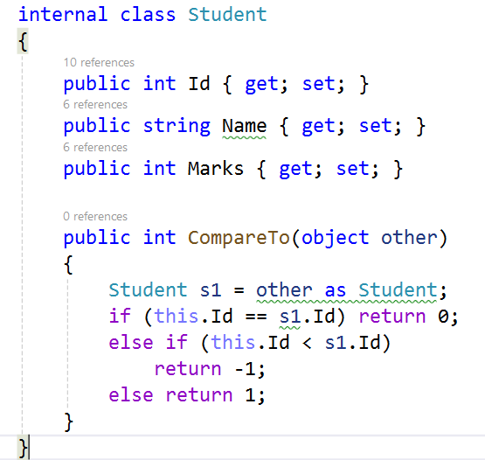
How to Implement IComparable ?
In the class Student we should implement IComparable interface as follows

Slide 6
Thank You

